Slide 1
Task 2
Predicting customer buying behaviour

Slide 2

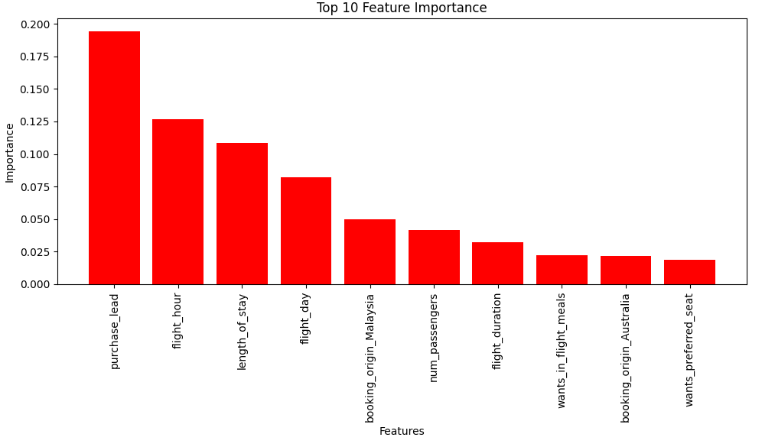
Insights
Evaluation metrics of Random Forest
Feature Importance Plot
Prepared the data set by extracting a new feature, by splitting the existing column ‘Route’ into 2 columns Origin and Destination.
Trained our data on Random forest classifier and obtained the evaluation metrics.
Extracted the 10 important features that contributed the most towards the classification and visualized it.

